Slide 1
Business Analysis of H1 Financial Statement
Sword Group H1 Financial Statement Analysis

Slide 2
Tasks:
How did Sword Group perform in the Energy sector compared to last year?
How has Sword Group’s work with Governments and the Public Sector evolved?
What role did Finance, Health & Telecom clients play in revenue trends?
How does the overall sector mix influence Sword’s growth strategy?
Are margins (EBITDA, EBIT) sustainable across these sectors?
How are acquisitions (e.g., iDelta Ltd in finance) supporting growth in strategic sectors?
What are the risks and opportunities in financial stability (cash flow, and debt)?

Slide 3
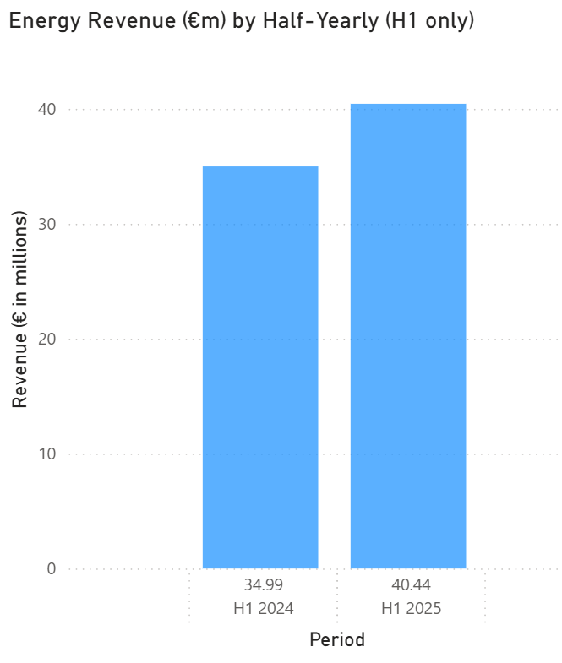
How did Sword Group perform in the Energy sector compared to last year?
Outcome:
Energy revenue increased by 15.58% (+€5.45M).
Reason:
Likely driven by increased demand for digital transformation in energy.
Digital transformation in the core services provided by Sword Group (infrastructure monitoring, cybersecurity, and data solutions)
+15.58%

Slide 4
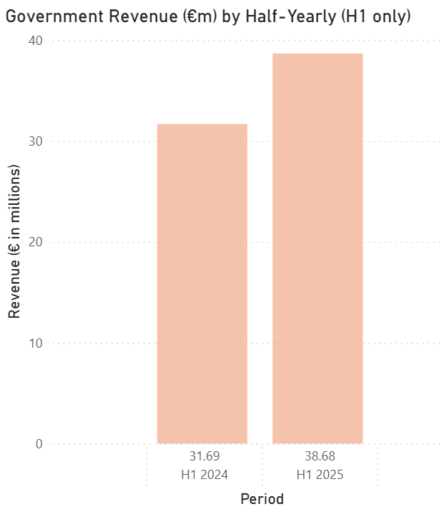
HOW HAS SWORD GROUP’S WORK WITH GOVERNMENTS AND THE PUBLIC SECTOR EVOLVED?
+ 22.06 %
Outcome:
Government and the public revenue increased by 22.06% (+€6.99M).
Reason:
Stronger engagement with governments and public sector clients, likely tied to digitalization mandates and EU-funded programs.

Slide 5
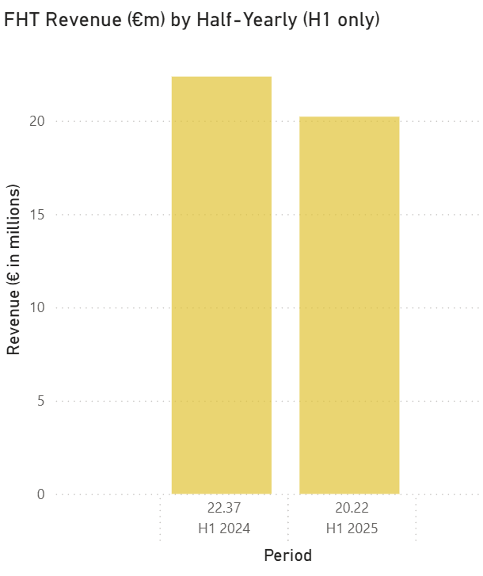
What role did Finance, Health & Telecom clients play in revenue trends?
-9.61 %
Outcome:
Energy revenue decreased by 9.61% (-€2.15M).
Reason:
Likely Tougher competition in financial services IT.
Clients reducing discretionary IT spend.
Concerning, especially due to the recent acquisition of iDelta Ltd

Slide 6
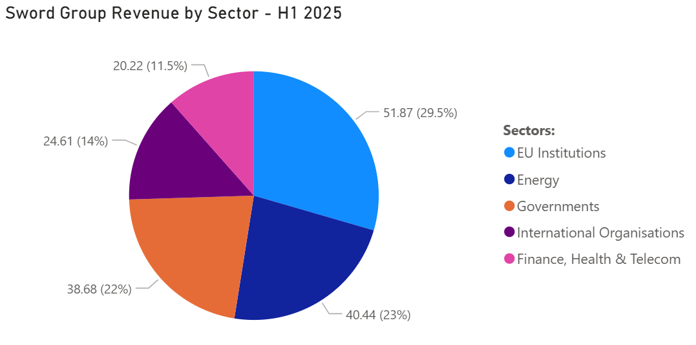
How does the overall sector mix influence Sword’s growth strategy?
 | Energy | FHT | Government | International Organisation | EU Institutions
2024 Vs 2025 (%) | +15.58% | -9.61% | +22.06% | -46.04% | +133.23%
2024 Vs 2025 (€m) | +5.46M | -2.15M | +6.99M | -21.00M | 29.63M
Outcome:
Decrease in the FHT and International Organizations sectors.
Increase in EU Institutions, Government, and Energy.
Reason:
Likely focusing on local and EU sectors for more control.
EU Institutions surged, more than doubling, likely due to a large framework contract Sword secured.
Possibly becoming a trusted digital partner for EU agencies, which provides predictable revenue streams.

Slide 7
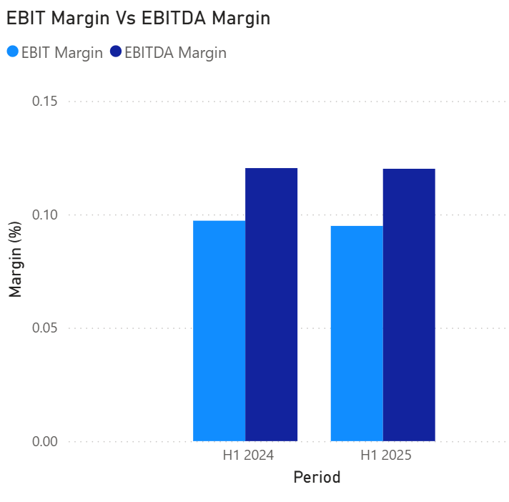
Are margins (EBITDA, and EBIT) sustainable across these sectors?
Very minor changes to EBITDA (-0.01%) and EBIT (-0.23%)
Outcome:
Although minor, both EBITDA and EBIT margins reduced by -0.01% and -0.23% respectively.
Reason:
Rising staff costs (+€8.7m) and external charges offset revenue growth.
All indications show stable costs across sectors.

Slide 8
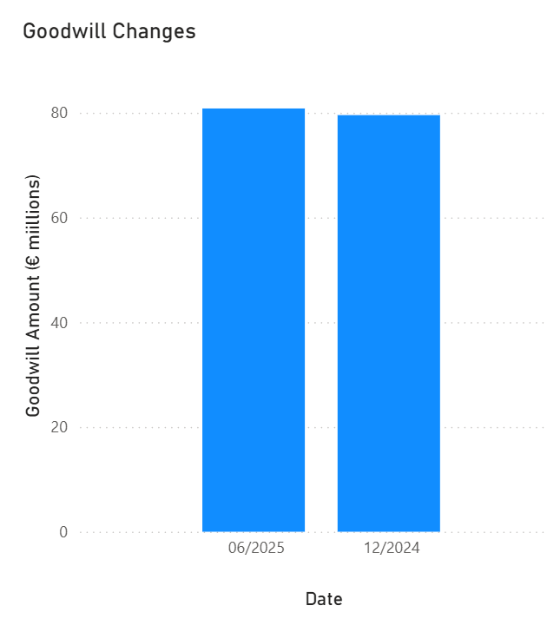
How are acquisitions (iDelta Ltd in finance) supporting growth in strategic sectors?
Outcome:
Goodwill increased by +1.60% (€1.27M).
Reason:
Driven mainly by the acquisition of iDelta Ltd (UK) in April 2025.
Possibly using acquisitions selectively to strengthen its finance & AI sector.
+1.60%

Slide 9
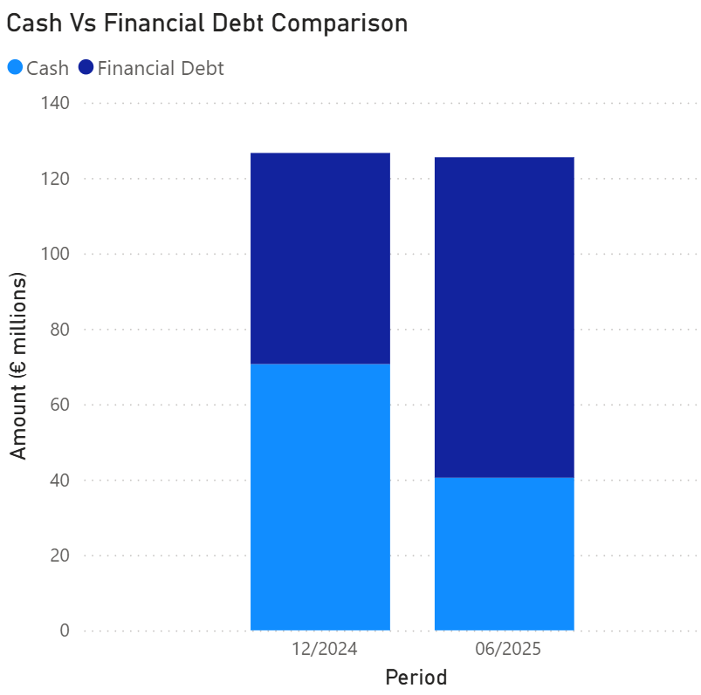
What are the risks and opportunities in financial stability (cash flow and debt)?
Outcome:
Cash decreased -30.1M
Debt increased by +29.0M
Reason:
now leveraged, with reduced financial flexibility. This could limit the ability to invest further without refinancing.
Acquisition spending (iDelta).
Dividends paid (€18.9m).
Higher debt financing for possible expansion.
44.2%
67.8%
55.8%
32.3%
A 23.6% shift in debt to cash ratio.

Slide 10
Summary:
Sword Group’s H1 2025 shows robust growth in Energy, Government, and EU Institutions, balanced by weaknesses in Finance/Health/Telecom and a worsening debt position.
Strategic focus should be on public & energy sectors, integrating acquisitions effectively, and restoring financial flexibility.

